Slide 1

DEPARTMENT OF INFORMATION TECHNOLOGY
FACIAL EXPRESSION BASED SMART MUSIC PLAYER
GUIDED BY:
Dr. NALINI PRIYA
Professor
DEPT OF IT
Batch No – 16
FAZIL MOHAMED M 212219220008
SHYAM PRAKASH V 212219220046
THENNARASU M 212219220055

Slide 2
AGENDA
INTRODUCTION
OBJECTIVE
SCOPE
LITERATURE SURVEY (in Tabular column)
EXISTING SYSTEM
PROBLEM DEFINITION
PROPOSED SYSTEM
SYSTEM ARCHITECTURE
MODULES (with Description and Flowchart/Module Mapping)
OUTPUTS (Screenshots and Results)
SWOT Analysis
CONCLUSION
FUTURE ENHANCEMENT
REFERENCES

Slide 3
INTRODUCTION
Human often use nonverbal cues such as hand gestures, facial expressions, and tone of the voice to express feelings in interpersonal communications. The face of the human is an important organ of an individual’s body and it plays an important role in extraction of an individual’s behavior and emotional state. Facial expression provides current mind state of person. Listening to music affects the human brain activities. Emotion based music player with automated playlist can help users to maintain a particular emotional state.
This research proposes an emotion based music player that creates a playlists based on captured photos of the user.
Manual sorting of a playlist and annotation of songs, in accordance with the current emotion, is more time consuming and quite tedious.
This paper presents an algorithm that not only automates the process of generating an audio playlist, but also to classify those songs which are newly added and the main task is to capture current mood of person and to play song accordingly.

Slide 4
OBJECTIVE
The most important goal is to make change the mood of person if it is a negative one such as sad, depressed. This model is validated by testing the system against user dependent and user independent dataset. The goal is to reduce the overall computational time and the cost of the designed system. It also aims at increasing the accuracy of the system.

Slide 5
SCOPE
The experiment was performed on a small dataset and limited number of features, in future it can be improved by adding more features like age, weather etc. More number of attributes will improvise decision making and prediction of song. Each user has it’s own preferences about what kind of song is to be played for corresponding mood. for e.g., some users listen sad songs when they are sad while some may prefer happy songs to change their mood. Collecting this data from every user can help us build better user specific radio application. Implementing this prototype in current music applications can provide better music experince to user.

Slide 6
LITERATURE SURVEY
S.NO | TITLE | AUTHOR | YEAR | CONTENT
1 | Mood based Music Recommendation System | Mahadik, A., Milgir, S., Jagan, V., Kavathekar, V., & Patel, J. | 2022 | In this work, they targeted to improve the emotional state of the person and make him happy, by recognizing the persons emotion and plays corresponding music which helps user in changing their mood. Music's magical power has been scientifically established and people enjoy listening to music that reflects their emotional feelings, it is a stress-relieving tool and has the ability to control a wide range of psychological states. They used Viola Jones algorithm, Data augmentation and CoAtNet algorithm to detect the emotion of a person.

Slide 7
S.NO | TITLE | AUTHOR | YEAR | CONTENT
2 | Moodify: Smart Music Player based on Facial Emotions | Srinayani, M., Jahnavi, P. N., & Kavishree, S. | 2021 | In this paper, they presented an affective cross-platform music player, which recommends music based on the real-time mood of the user. This music player contains three modules: Emotion Module, Music Classification Module and Recommendation Module. The Emotion Module takes an image of the user's face as an input and makes use of deep learning algorithms to identify their mood. The Music Classification Module makes use of audio features to achieve a remarkable result of 97.69% while classifying songs into 4 different mood classes. The Recommendation Module suggests songs to the user by mapping their emotions to the mood type of the song, taking into consideration the preferences of the user.

Slide 8
S.NO | TITLE | AUTHOR | YEAR | CONTENT
3 | Facial Feature Analysis using Deep Convolutional Neural Networks and HAAR Classifier for Real-Time Emotion Detection | Surendar, B. I., Chakravarthy, P. S. S., Thangavel, R., & Swarnalatha, P | 2022 | This paper will study various algorithms based on classification to provide a clear methodology to i) classify songs into 4 mood categories ii) detect users mood through his facial expressions and then combine the two to generate user customized music playlist. Songs have been classified by two approaches; by directly training the models namely KNN, Support Vector Machines (SVM), HAAR, Random Forest and MLP using selected audio features and by predicting a songs arousal and valence values using these audio features.

Slide 9
S.NO | TITLE | AUTHOR | YEAR | CONTENT
4 | A real time face emotion classification and recognition using deep learning model | Dr. Shaik Asif Hussain and Ahlam Salim Abdallah Al Balushi | 2020 | The smart music player is an application that runs based on the idea that it can detect a person's mood based on the expression on his face. The expression on the face is detected using convoluted neural networks (CNN). The set of images is taken from the camera of the device and these images are given to a pre-trained CNN which returns facial expression to application. Based on facial expression a song playlist is suggested.

Slide 10
EXISTING SYSTEM
EMO Player:
Emo player (an emotion-based music player) is a novel approach that helps the user to automatically play songs based on the emotions of the user.
SoundTree:
Sound Tree is a music recommendation system which can be integrated to an external web application and deployed as a web service. It uses people-to-people correlation based on the user's past behaviour such as previously listened, downloaded songs
Music.AI:
It uses the list of moods as input for mood of the user and suggests songs based on the selected mood. It is a combination of Collaborative filtering based and Content based filtering models. Emotion, time, ambience and learning history are the features taken into account for music recommendation.

Slide 11
DRAWBACKS
Chances of obtaining incorrect playlist due to poor recognition of user input (image).
Does not provide much accuracy.
Existing systems are very complex in terms of memory requirements.

Slide 12
PROBLEM DEFINITION
Develop a system that presents a cross-platform music player, which recommends music based on the real-time mood of the user through a web camera using Machine Learning Algorithms.

Slide 13
PROPOSED SYSTEM
The proposed system benefits us to present interaction between the user and the music player. The purpose of the system is to capture the face properly with the camera. Captured images are fed into the Convolutional Neural Network which predicts the emotion. Then emotion derived from the captured image is used to get a playlist of songs.
The main aim of our proposed system is to provide a music playlist automatically to change the user's moods, which can be happy, sad, natural, or surprised. The proposed system detects the emotions, then a selected playlist is going to be presented that contains the foremost suitable sorts of music that will enhance the mood of the person positively.

Slide 14



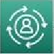

SYSTEM ARCHITECTURE
User
Face Detection
Open Camera
Return to main screen
Display error message
NO
Is face count > 0
YES
Detected Mood passed to Firebase
Fetch Songs
Mood Detection Algorithm(CNN)
Song displayed to user as per mood detected
Firebase Storage

Slide 15
MODULES
Music recommendation based on facial emotion recognition contains three modules.
• Face Recognition: Here it will take the user's face as input. The convolutional neural network is programmed to evaluate the features of the user image.
• Emotion Detection: In this section extraction of the features of the user image is done to detect the emotion and depending on the user's emotions, the system will generate captions.
• Music Recommendation: Song is suggested by the recommendation module to the user by mapping their emotions to the mood type of the song.

Slide 16
Database Description
We built the Convolutional Neural Network model using the Kaggle dataset. The database is FER2013 which is split into two parts training and testing dataset. The training dataset consists of 24176 and the testing dataset contains 6043 images. There are 48x48 pixel grayscale images of faces in the dataset.
Each image in FER-2013 is labeled as one of five emotions: happy, sad, angry, surprise, and neutral. The faces are automatically registered so that they are more or less centered in each image and take up about the same amount of space. TThe FER-2013 dataset was created by gathering the results of a Google image search of every emotion and synonyms of the emotions.
FER systems being trained on an imbalanced dataset may perform well on dominant emotions such as happy, sad, angry, neutral, and surprised but they perform poorly on the under -represented ones like disgust and fear

Slide 17
Face Recognition Module
This is the process in which algorithms are developed and trained to properly locate faces or objects in object detection or related system in images. This detection can be real-time from a video frame or images.
Face detection uses such classifiers, which are algorithms that detect what's either a face (1) or not a face (0) in an image. Classifiers are trained to detect faces using numbers of images to get more accuracy.
The main aim of face detection is to spot the face within the frame by re-ducing external noises and other factors.

Slide 18
Emotion Detection Module
Convolution neural network architecture applies filters or feature detectors to the input image to get the feature maps or activation maps . Feature detectors or filters help in identifying various features pre-sent in the image such as edges, vertical lines, horizontal lines, bends, etc.
We give an input image then the CNN model returns the results. Emotion detection is performed by loading the model which is trained by weights using CNN. When we take the real-time image by a user then that image was sent to the pre-trained CNN model, then predict the emotion and adds the label to the image.

Slide 19
Music Recommendation Module
Songs Database:
We created a database for songs. It consists of 10 to 15 songs per emotion. As we all know music is un-doubtedly involved in enhancing our mood. So, suppose a user is sad then the system will recommend such a music playlist which motivates him or her and by this automatic mood will be delighted.
Music Playlist Recommendation:
By using the emotion module real-time emotion of the user is detected. This will give the labels like Happy, Sad, Angry, Sur-prise, and Neutral. Using the os.listdir() method in python we connected these labels with the folders of the songs database which we have created. This method of os.listdir() is used to get the list of any file in the specified directories.

Slide 20
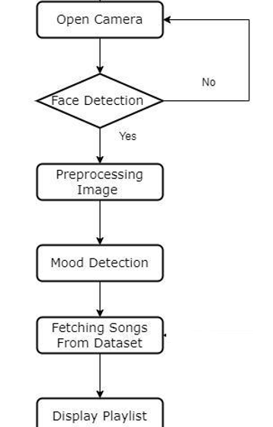
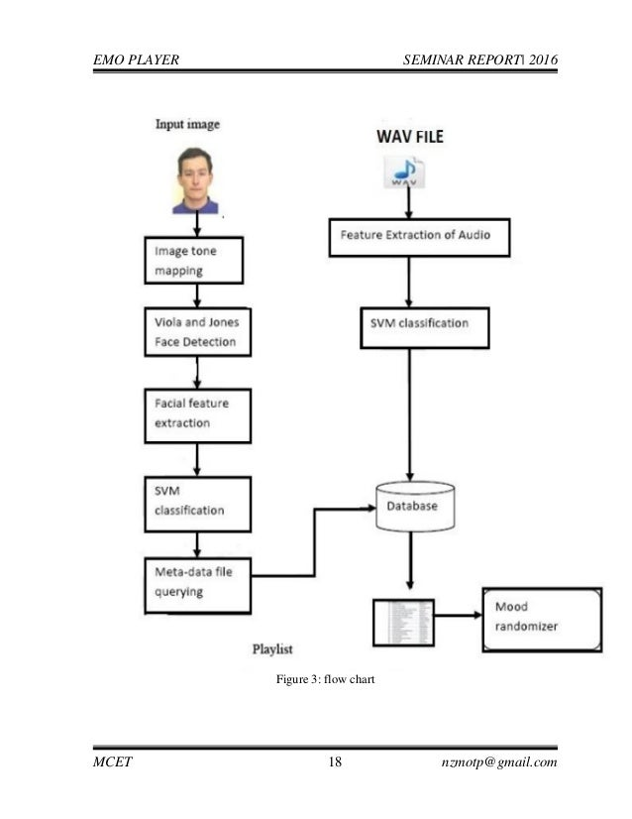
DATAFLOW DIAGRAM

Slide 21
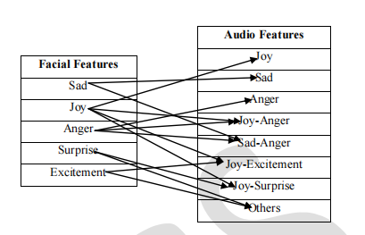
Modules Mapping

Slide 22
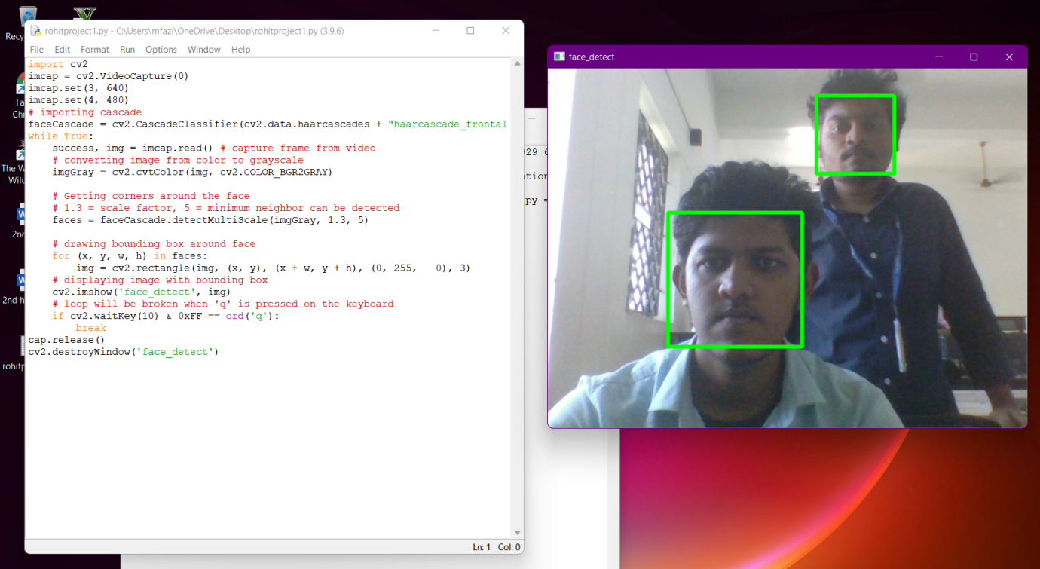
OUTPUTS

Slide 23
SWOT ANALYSIS
Strength -- Skills of music therapists. This work is extremely dedicated to act as a therapist to provide the best possible treatment programs through music to the clients to ease their Mind.Acts as an Personal Therapist.
Weakness --Lack of Lighting or poor quality of images can leads to misjudge the client’s Emotion  Sometimes Inaccurate due to Limited Dataset Only Limited Songs are used .
Opportunity -- Third party certification possible.
Threat --Music Therapy is not yet popular around the Globe  No every one is Same,therefore the playlist may not satisfy every client.

Slide 24
CONCLUSION
This research has been developed with an aim tocontribute greatly in the field of machine learning anddeep learning technology. It performs sorting out of the music based on one's emotions, such as whether theyare happy or sad. Therefore, the main purpose of this research is to develop a web application in which a realtime image of the user can be captured and further based on the mood detected, a list of songs could be recommended. It is especially useful for reviving the user when he or she has free time and wants to listen to music that is appropriate for the scenario. The mood detectionmodel, having an accuracy of 91%, is capable of detecting five moods accurately, viz. happy, sad, neutral, fear, and anger. In addition to that, it will have the ability to suggest a list of songs that would be suitable for the detected mood.

Slide 25
FUTURE ENHANCEMENT
As of now we are taking the music from the database available online. But in future we can even take directly take songs from online where different kind of options will come like languages, newest released song, old songs from 80’s and 90’s etc. The future scope of this proposed method is that it can be used for music therapy session which will help music therapists to help patients suffering from depression, mental illness etc. It can also be implemented as a mobile app in future which will be convenient for the user.
The current system does not perform well in extremely bad light conditions and poor camera resolution thereby provides an opportunity to add some functionality as a solution in the future.

Slide 26
REFERENCES
[1]Mahadik, A., Milgir, S., Jagan, V., Kavathekar, V., & Patel, J. (2022). Mood based Music Recommendation System. International Journal of Engineering Research & Technology.
[2]Srinayani, M., Jahnavi, P. N., & Kavishree, S. (2021). Moodify: Smart Music Player based on Facial Emotions. International Research Journal of Engineering and Technology.
[3] Hemanth, P., Adarsh, Aswani, C.B., Ajith, P., & Kumar, V. A., (2018). EMO PLAYER: Emotion Based Music Player, International Research Journal of Engineering and Technology.
[4]Surendar, B. I., Chakravarthy, P. S. S., Thangavel, R., & Swarnalatha, P. (2022). Facial Feature Analysis using Deep Convolutional Neural Networks and HAAR Classifier for Real-Time Emotion Detection, International Journal Of Engineering Research & Technology (IJERT).
[5]Dr. Shaik Asif Hussain and Ahlam Salim Abdallah Al Balushi, “A real time face emotion classification and recognition using deep learning model”, (2020) Journal. of Phys.: Conf. Ser. 1432 012087.

Slide 27
REFERENCES
[6]A. Abdul, J. Chen, H.-Y. Liao, and S.-H. Chang, “An Emotion-Aware Personalized Music Recommendation System Using a Convolutional Neural Networks Approach,” Applied Sciences, vol. 8, no. 7, p. 1103, Jul. 2021.
[7]Hemanth P,Adarsh ,Aswani C.B, Ajith P, Veena A Kumar, “EMO PLAYER: Emotion Based Music Player”, International Research Journal of Engineering and Technology (IRJET), vol. 5, no. 4, April 2018.
[8]H. Immanuel James, J. James Anto Arnold, J. Maria Masilla Ruban, M. Tamilarasan, R. Saranya” EMOTION BASED MUSIC RECOMMENDATION SYSTEM”: pISSN: 2395-0072 , IRJET 2019.
[9]Hafeez Kabani, Sharik Khan , Omar Khan , Shabana Tadvi”Emotion Based Music Player” International Journal of Engineering Research and General Science Volume 3, Issue 1, January-February , 2017.
[10]T.-H. Wang and J.-J.J. Lien, “Facial Expression Recognition System Based on Rigid and Non-Rigid Motion Separation and 3D Pose Estimation” J. Pattern Recognition , vol. 42, no. 5,pp. 962-977, 2016.

